Slide 1

Emotion detection from Tweets
DSCI 521
Josh Clark
Notes:
Hello, my name is Josh Clark and I will be presenting a project on emotion detection from tweets.

Slide 2
Goal: Predict the sentiment from text
Applications:
Monitor social media for hate speech and discrimination
Detecting mental health issues and self harm on social media and messaging apps
Prioritizing customer complaints by severity
Notes:
The goal of this project is to extract emotion, or sentiment, from text. One thing that is notoriously difficult for machines to do, even in science fiction. However, this is quite possible with today’s advances in NLP and has many applications. Social media can be monitored for hate speech and discrimination automatically. There is often not enough manpower to monitor everything on the internet these days and it is certainly a large problem on many platforms. We can also detect either subtle trends or large outbursts of mental health issues or self harm on social media sites and messaging apps to help identify those struggling with it and are crying for help. Another one that may secure more funding for this technology is prioritizing customer complaints for a variety of industries. These can be people simply complaining that the product they bought didn’t meet their expectations but can also be extended to things like complaining about major power outages and natural disasters online. The phrasing of complaints can give different connotation and sentiment to the text that may help in identifying the severity of an issue.

Slide 3
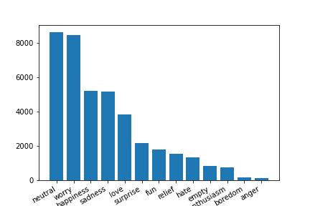
Sentiment Distribution
Notes:
We start off with 13 different sentiments with a very skewed graph with some emotions like neutral and worry being very high, and others like boredom and anger being very low. We look to simplify this by combining anger and hate, and happiness and fun, and throwing out boredom, enthusiasm, empty, and relief.

Slide 4
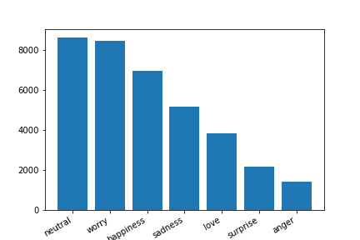
Sentiment Distribution after simplifying
Notes:
Now we only have to worry about 7 different emotions which will be easier to manage. However, this still has a very visible class imbalance that needs to be addressed. In order to achieve this, it was thought that the total number of tweets for each sentiment should be capped at about 3000 so that there is a relatively even playing field for each and doesn’t compromise too much of the data overall.

Slide 5
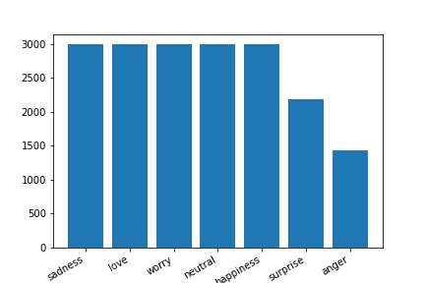
Sentiment Distribution after capping
Notes:
Now you can see that we have a much more even representation of each sentiment, although, as you will see later, this will come back to haunt us later on.

Slide 6
Example tweets from dataset
Kaggle Dataset credited here: https://www.kaggle.com/datasets/pashupatigupta/emotion-detection-from-text
sentiment content
0 sadness Layin n bed with a headache ughhhh...waitin o...
1 sadness Funeral ceremony...gloomy friday...
2 worry Hmmm. http://www.djhero.com/ is down
3 sadness @kelcouch I'm sorry at least it's Friday?
4 sadness Ugh! I have to beat this stupid song to get to...
5 sadness @BrodyJenner if u watch the hills in london u ...
6 surprise Got the news
7 sadness The storm is here and the electricity is gone
8 love @annarosekerr agreed
9 sadness How are YOU convinced that I have always wante...
Notes:
The actual tweets from the dataset we will be using can be seen here. As you can see, much of the text is plagued with misspelling, texting slang, twitter handles, URLs, and random punctuation and other nonsense words. These will greatly affect the accuracy of our classifier model and will need to be removed. We will also remove common stopwords and try to undo some of the texting slang to correctly spelled words so they’re not counted separately.

Slide 7
Example tweets from dataset
Kaggle Dataset credited here: https://www.kaggle.com/datasets/pashupatigupta/emotion-detection-from-text
sentiment content
0 sadness layin and bed headache ughhhh waitin call
1 sadness funeral ceremony gloomy friday
2 worry hmmm
3 sadness im sorry friday
4 sadness ugh beat stupid song rude
5 sadness u watch hills london you realise tourture week...
6 surprise got news
7 sadness storm electricity gone
8 love agreed
9 sadness convinced wanted you signals damn think lost f...
Notes:
This is after performing several regex substitutions. Notice that there are still misspelled words, and fewer words overall than before. Misspelled words are hard to identify since we are building a database of words from scratch, and because tweets are so short, only a few words “survive” to be used as features.

Slide 8
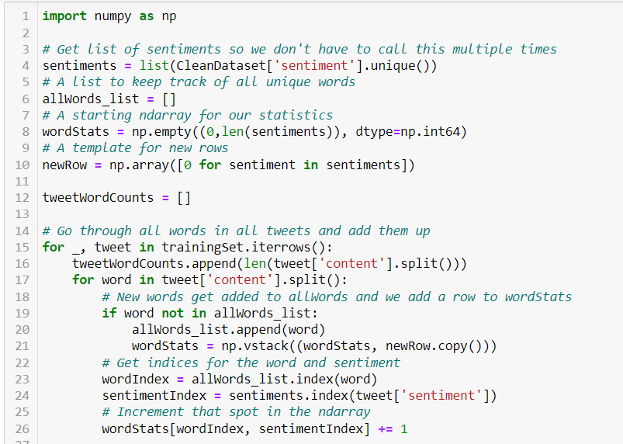
Counting up all the words
Notes:
Here we can see the code used to count the number of words for each sentiment. We take each word in each tweet, add it to our list of words if its not already contained, and tally how many times it was mentioned in a tweet for each sentiment

Slide 9
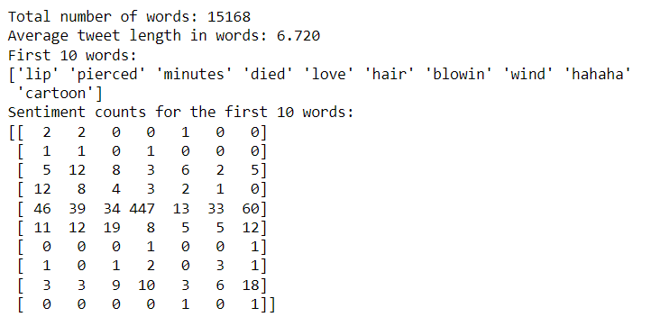
Dataset statistics
Notes:
Here you can see the results of the operation. We have 15,168 unique words and an average of 6.72 words per tweet in our training set. You can also see the first 10 words and their sentiment counts in an ndarray. The words are arranged in rows and the sentiments as columns. You can see that some words, such as “love” appear many times, but others like “blowin” appear only twice. Because we only have “blowin” appearing twice, we are likely to get an inaccurate prediction for tweets containing this word. However, tweets that contain the word “love” are more likely to be understood because we have a much more dynamic distribution of representation in all sentiments.

Slide 10
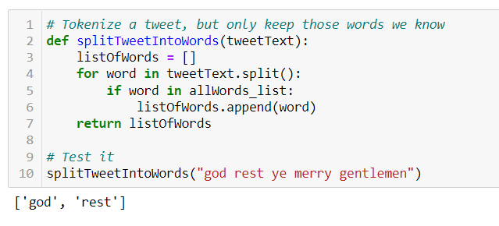
Extracting known words from tweets
Notes:
In order to process both training and testing sets before creating our logistic regression statistics, we will need to filter the words in a tweet by the ones we know in our database. This won’t remove any from our training set, but there are plenty of words in our testing set that will be.

Slide 11
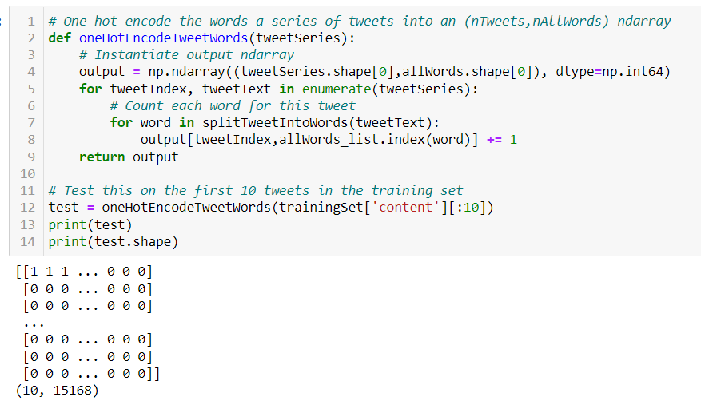
One hot encoding words as features
Notes:
Here we build a statistical model for our logistic regression classifier by one hot encoding the words as features for all known words and tallying their occurrences for each tweet as rows. Note that much of this matrix will be 0s because there are many more known words than there are words in each tweet.

Slide 12
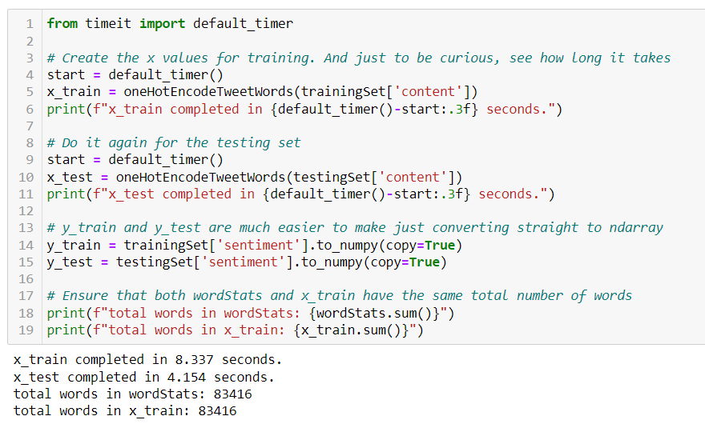
Encoding the training and testing sets
Notes:
Now we can one hot encode both training and testing sets and we verify that counting words this way produces the total number of words as we did before, the first time.

Slide 13
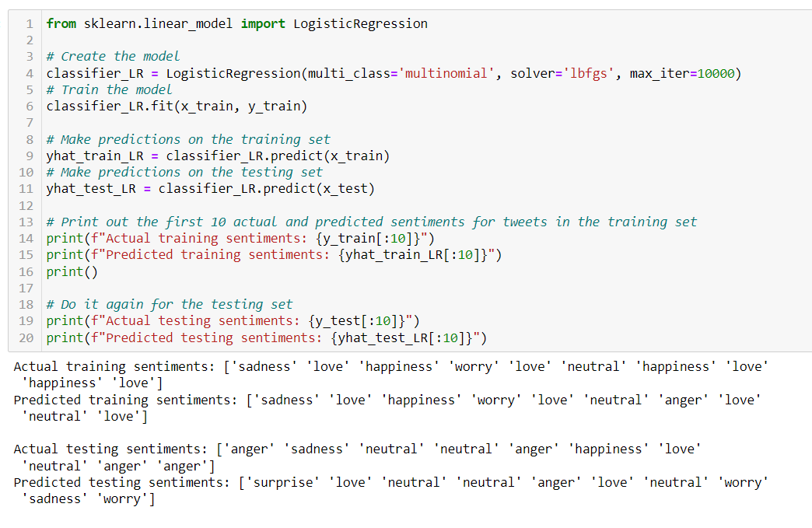
Performing Multinomial Logistic Regression
Notes:
Now we can build a Logistic Regression model on this data using sklearn and run it on both the training and testing sets. Here you can see the first 10 actual and predicted target values for both sets.

Slide 14
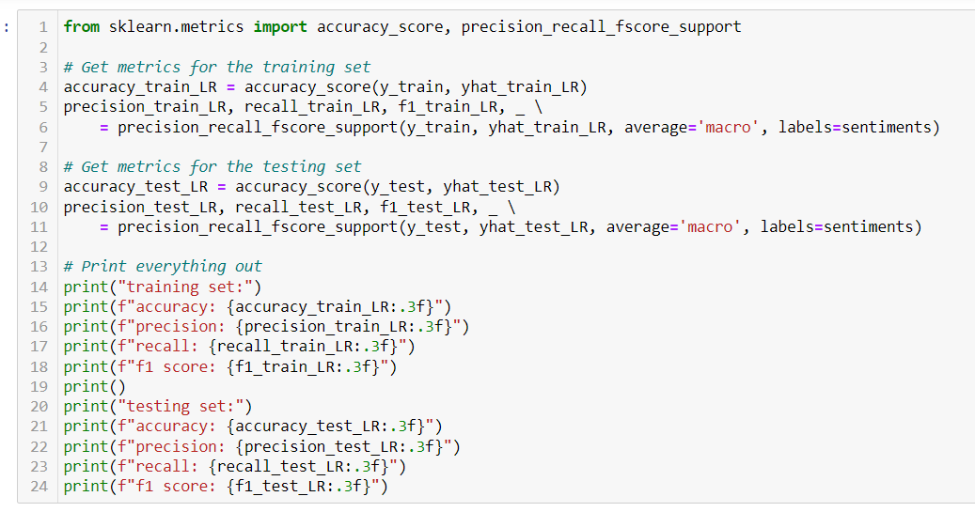
Creating metrics
Notes:
Now we need to calculate statistics on how well our model did. Again, we can use sklearn for this to simplify things and we calculate accuracy, precision, recall, and f1 score for both sets.

Slide 15
Final results
Training set
Testing set
Accuracy | 0.833
Precision | 0.846
Recall | 0.831
F1 score | 0.836
Accuracy | 0.332
Precision | 0.335
Recall | 0.320
F1 score | 0.323
Notes:
These are the final results. We got about 83% accuracy for training, but only about 33% for testing. This sounds bad, but its actually to be expected given our data. Remember that we only have 15,000 unique words in our dataset, and most English-speaking people commonly use about 100,000 in day-to-day language. This means that this is a very high chance that the words in the unseen tweets will not be in our dataset. Also, since some words have very very few occurrences, these can have very skewed probabilities and since there is only an average of 6.72 words per tweet in our training set (and likely even less in our testing set) we don’t have very many words to go off of for each tweet. Even though these numbers are low, I think they are still impressive given our starting data and still show that this can be used if there was more data to start with. Perhaps we shouldn’t have dropped some of the data and found other ways to deal with class imbalance.

Slide 16
Future Work
Get more data for less common emotions
Get better libraries for cleaning and processing raw text
Try different types of classifiers such as Naive Bayes, Decision Trees, K Nearest Neighbors, or Support Vector Machines
Experiment with custom Neural Networks
Examine the effect of class imbalance on each sentiment
Examine the use of Principal Component Analysis to detect the most meaningful words instead of relying on a library to filter out stop words
Create more visuals to showcase the results that we find
Notes:
There are many things that I would have liked to include in this project that I could not because of time constraints and other reasons, but here are some ideas for how to further this work. I originally planned to build multiple classifiers and compare and some others might do a better job than logistic regression. It would also help if we had a much much larger dataset, evenly distributed labels, or at least adequately detailed minority class labels, and had better text processing to account for all of the misspelling and slang that I was unable to take out. Class imbalance was another thing that I could have looked more into to see if there are ways to compensate. I was thinking of running PCA on all words, however reducing the number of words means that there is even less chance that the words in unseen tweets intersect with our database of words. I would have also liked to present more and better graphs to you guys to show the data we were able to gather from this investigation.

Slide 17
Conclusion
Although our classifier scored poorly on unseen data, this is mostly due to the relatively small set of known words to work with. There are a large number of words that have not yet been seen and each tweet only has so many “clean” words available to be used as features. This does demonstrate that it is possible to predict sentiment in text, however, and would be worth further investigation. Thank you!
Notes:
As I said before, although our scores were low, I think this still demonstrates what could be done in this field even with the limitations that we had to work with. I hope that I can someday further this project and investigate this further to see what other techniques could be used. If you have any suggestions, let me know! Thank you for your time!

